Slide 1


Water Quality Monitoring Dashboard for Kutch Region
By: Kutch, Gujarat India Chapter
https://omdena.com/omdena-chapter-page-india/

Slide 2
CONTENTS
Water Quality Standards
Literature Review
Satellite Data
Satellite Image Analysis
Water Quality Parameters Identification
Machine Learning
Dashboard
Potential Next Steps

Slide 3
Timeline
Identification of Water Quality Standards
Water Quality Parameters Literature Review
Satellite Image Availability
Data Pre-processing and Machine Learning Models
Dashboard GUI preparation
Dashboard Hosting and Integration on Web
Week 1
Week 1
Week 4
Week 5
Week 6
Week 3
Week 4
Week 2
Week 3
Satellite Image Analysis
Water Quality Index
Water Quality Parameters Identification

Slide 4
Water Quality Standards
PHYSICAL
INORGANIC
ORGANIC /
NUTRIENTS
BIOLOGICAL
pH
Temperature (deg Celsius)
Turbidity (NTU)
T.S.S.(Total Suspended Solids)
T.D.S.(Total Dissolved Solids)
Conductivity (mS/cm)
Magnesium
Alkalinity
Total hardness
Calcium hardness
Sodium Chloride(salinity)
Sulphate
Sodium
Nitrate(NO3)
Phosphate(PO4)
DO(Dissolved Oxygen)
COD(Chemical Oxygen Demand)
BOD(BioChemical Oxygen Demand)
Total Coliform(CFU)
Chlorophyll

Slide 5
Literature Review
Numerous remote sensing data incorporated with machine learning were evaluated and key points were noted, and different satellite sources were effectively adjusted.
A handful of the most notable sources are listed here: -
https://earthdata.nasa.gov/learn/pathfinders/water-quality-data-pathfinder
https://www.ncbi.nlm.nih.gov/pmc/articles/PMC5017463/
https://www.ncbi.nlm.nih.gov/pmc/articles/PMC6111878/
GITHUB -
robmarkcole/satellite-image-deep-learning: Resources for deep learning with satellite & aerial imagery
Exploring the Data
https://satellites.pro/
https://developers.google.com/earth-engine

Slide 6
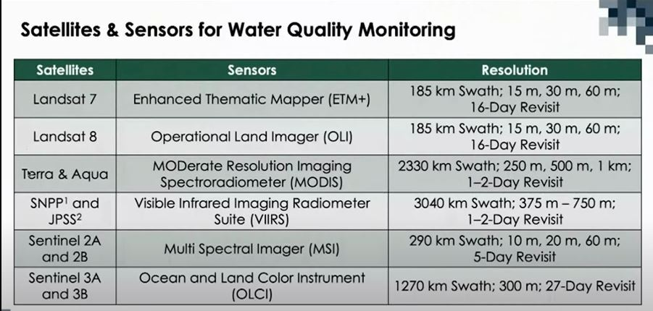
Satellite Data
Sentinel-2 can be used to map changes in land cover and to monitor the world’s forests. It also provides information on pollution in lakes and coastal waters.
The main objective of the Sentinel-3 mission is to measure sea surface topography, sea and land surface temperature, and ocean and land surface colour with high accuracy and reliability to support ocean forecasting systems, environmental monitoring and climate monitoring.

Slide 7
Satellite Image Analysis
pH
pH = 8.339-0.827*(B1/B8)
SALINITY
Salinity = (B11-B12)/(B11+B12)
TURBIDITY
Turbidity= (B4-B3)/(B4+B3)
LAND SURFACE TEMPERATURE
Land Surface Temperature = ST_B10* 0.00341802+149.0 – 273.15
CHLOROPHYLL
Chlorophyll = (B5-B4)/(B5+B4)
SUSPENDED MATTER
Suspended_matter = Oa08_radiance/Oa06_radiance
DISSOLVED ORGANIC MATTER
Dissolved Organic Matter = Oa08_radiance/Oa04_radiance
DISSOLVED OXYGEN
Dissolved Oxygen = -0.0167*B8+0.0067*B9+0.0083*B11+9.577

Slide 8
Water Quality Parameters Identification
1. pH
2. Salinity
3. Turbidity
4. Land Surface Temperature (LST)
5. Chlorophyll
6. Suspended matter
7. Dissolved Organic Matter (DOM)
8. Dissolved Oxygen

Slide 9
Machine Learning
DATA PRE-PROCESSING AND EXPLORATION
TRAINING AND TESTING DATA PREPARATION
MACHINE LEARNING MODELS
First we concatenated the individual data files.
Due to the lack of in-situ data in India for training, we applied the research based thresholds for labelling the records into ‘good’, ‘poor’ and ‘Needs treatment’ classes and generate our own training and testing data.
Various Machine learning models were applied on the final dataframe and the metrics were analysed and the best model was chosen with having a good validation accuracy.
Null Values :- nearly 60% of the data had null values so we decided to drop them.
Outliers :- Only dissolved oxygen showed data points outside of the IQR however to it’s high number, they couldn’t be considered as clear outliers.
We normalized the data using Min-Max scalar.
Among all the models we evaluated Random Forest Classifier performed best and was used for the final deployment.
No significant correlation between parameters were found except one relation between DOM and Suspended Matter.
Since the data was imbalanced, we used SMOTE to up-sample it, so there were balanced observations for each class.

Slide 10
Dashboard
Problem Statement - Water Quality Centralized Dashboard for Better Decision Making
Project Goals - Analysis, Interpretation and Visualization with comparison of Water Quality Limits
Location Chosen - Kutch Region (Harmisar, Shinai and Tappar Lake)
Developments Made - Identified Parameters, Selected Sources, Analyzing and Applying Formulas, Finalized Parameters along with Band, ML model with Good Accuracy, Interactive Dashboard
Project Endorsements - Projecting the water quality, Monitoring and Analyzing existing conditions, Identification of Parameters with Threshold Values
Select AOI Data Parameters - Water Body, Parameters, Latitude, Longitude, Dates
Visualizations - Lake Satellite Imaging using Sentinel
Project Summary - Water Quality Crisis, Ability of Decision Making, Real-Time Enforcement
Conclusion - Centralized Dashboard to check on with the Water Conditions visually in Real-Time.

Slide 11

Potential Next Steps
Decide airborne sensor or spaceborne sensor based on the size of the study area.
Choose the remote sensor with the suitable spatial, temporal, and spectral scales according to the problem to be solved.
Choose close dates of both remote sensor images and the in-situ samples to reach acceptable results.
Apply the proposed model on different in-situ sampling datasets in different regions to ensure model applicability and robustness.
Solve the problem of temporal scale (revisit times) by data fusion between over one remote sensing data to ﬁll the gaps of missing dates.
Use deep learning as a powerful machine to improve the prediction accuracy and try to solve the problem of extra bands of the hyperspectral sensors by using band selection and also generalize the model to predict the quality of water all-over the country.

Slide 12
Thank You
Tanisha Banik
Renju Zachariah
Sairam Kannan
Ishita Kheria
Bharati Panigrahi
Himanshu Mishra
Prathima Kadari
Deepali Bidwai
Drij Chudasama
Kiran Ryakala
PROJECT MANAGER: -
CHANCY SHAH

Slide 13
THANK YOU!

